Slide 1



Weekly Progress: Chatbot Responses Evaluation and Naver API Integration
On Development of an on-Premise AI Product Recommendation Model Using Open-Source LLM
Atique Md Monir Ahammod Bin (248810) 14 May 2025
Department of Artificial Intelligence Convergence

Slide 2

Project Description
Project Title
Development of an on-Premise AI Product Recommendation Model Using Open-Source LLM
Company: Narosu Co. Ltd.
Project Description
The e-commerce market is becoming increasingly competitive, requiring advanced recommendation systems.
Large marketplaces use sophisticated AI models, but independent online store operators lack such solutions.
This project aims to develop an AI-powered product recommendation system tailored for self-managed online stores.
By analyzing customer preferences, the system will suggest products that align with their interests.
Project Objective
Develop an AI-based search and recommendation system that analyzes user input sentences and recommends the TOP 5 most relevant products based on semantic similarity.
Utilize Natural Language Processing (NLP) and vector search technology to provide a highly refined search experience.
Deploy in an on-premise environment to ensure data privacy and full control over the recommendation process.
1

Slide 3

Company Requirements
Selected Model and Vector Store:
Embedding Model: text-embedding-ada-002
Vector DB/Search: Qdrant
LLM Reasoning: Llama 3.1 8B instant
LangChain Framework for LLM
UI Framework: Gradio
API Architecture: Gradio + FastAPI
2

Slide 4

System Configuration (AI Model) Diagram
3

Slide 5
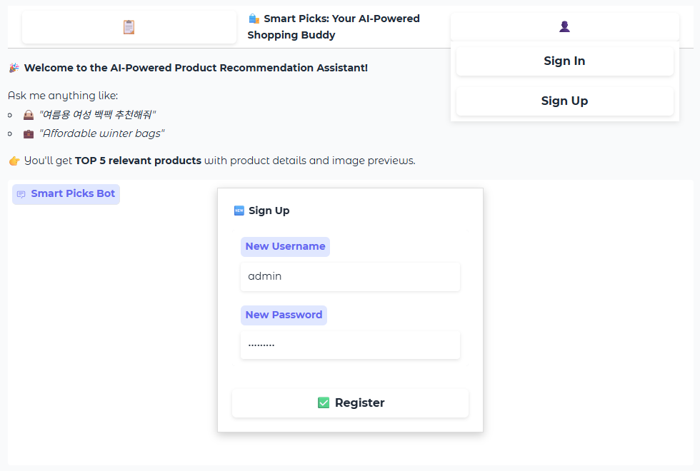
ChatBot UI Update with Login/Signup
4

Slide 6
Project Schedule (Gantt Chart)
Phase | 2025
 | March |  |  |  | April |  |  |  | May |  |  |  | June
 | 1 | 2 | 3 | 4 | 1 | 2 | 3 | 4 | 1 | 2 | 3 | 4 | 1 | 2
Project Understanding and Data Collection
Data Analysis and Pre-processing
Model Selection and Training
System (RAG) Development
Chatbot Development
Testing and Deployment
5

Slide 7
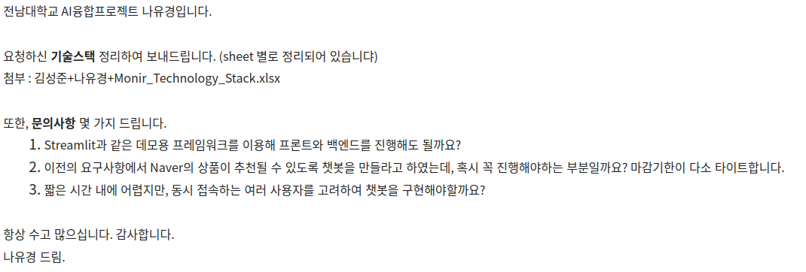
Previous Communication with Company
Asked some queries to the company:
6

Slide 8
Evaluation Metrics in Product Recommendation System
Metric | Description | Your Use Case | Goal
Precision@K | Fraction of top-K recommended products that are actually relevant. | Measures how accurate the top product picks are. | High precision = fewer irrelevant suggestions.
Recall@K | Fraction of relevant products that appear in the top-K recommendations. | Measures how completely relevant products are captured. | High recall = fewer missed good products.
NDCG@K | Measures ranking quality; rewards putting relevant items near the top. | Ensures the most suitable products appear first in the list. | Good rank order = better UX.
MAP | Average of precision values at ranks of all relevant items (overall score). | Summarizes precision across positions — helpful for comparing system performance. | Balanced overview of recommendation quality.
7

Slide 9
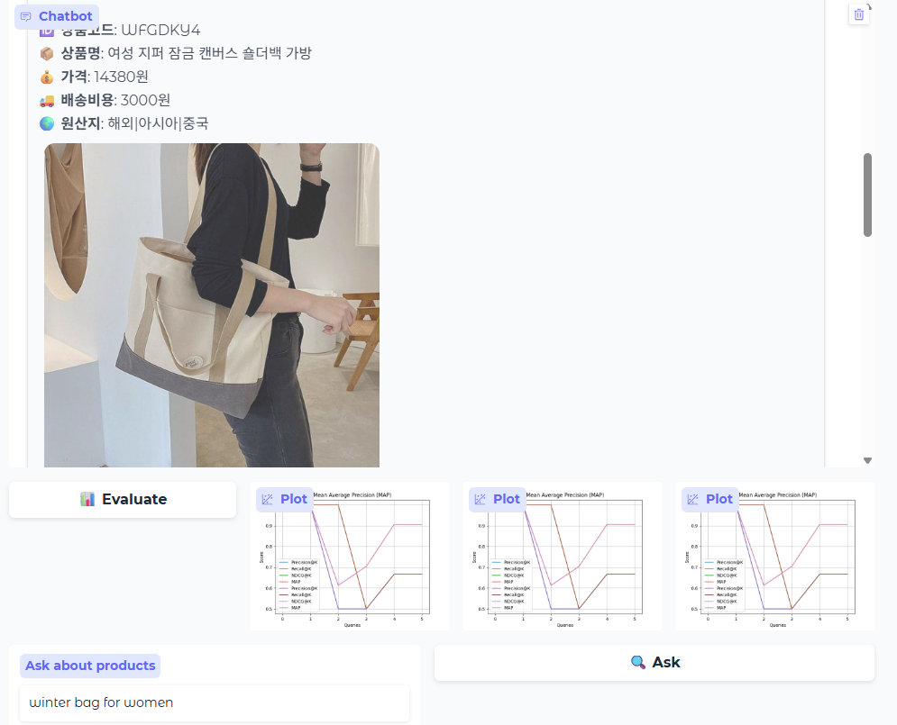
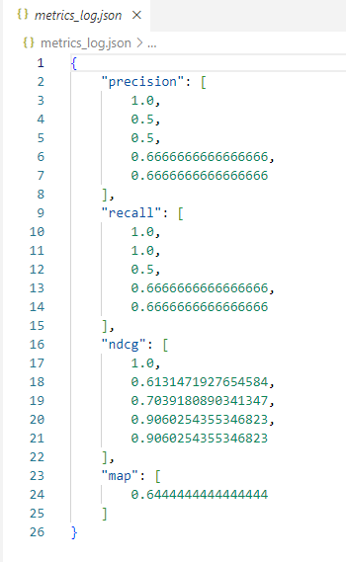
Recommendation Evaluation Using Metrics
User Query: Winter bag for women
8

Slide 10
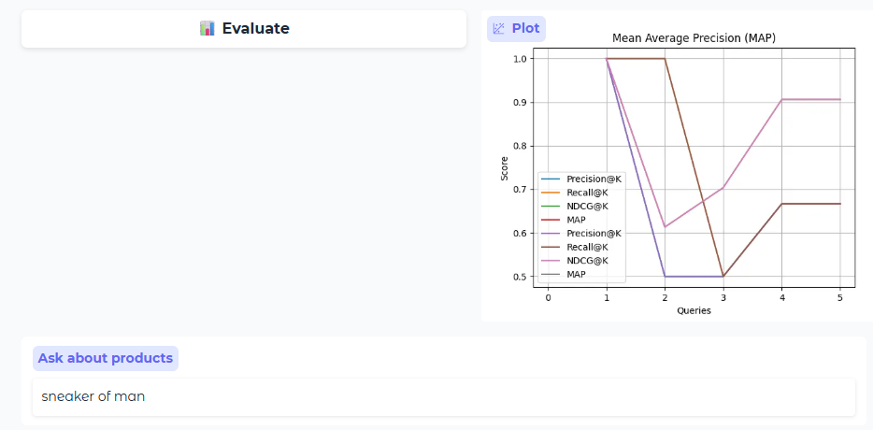
Evaluation Visualization Using Matplotlib
9

Slide 11
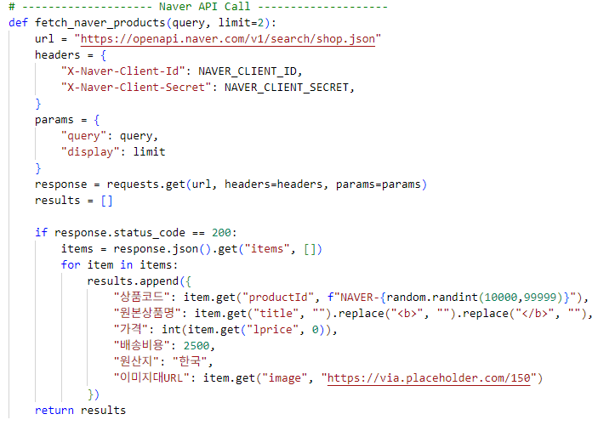
Naver Product API Call
Naver API call code
10

Slide 12
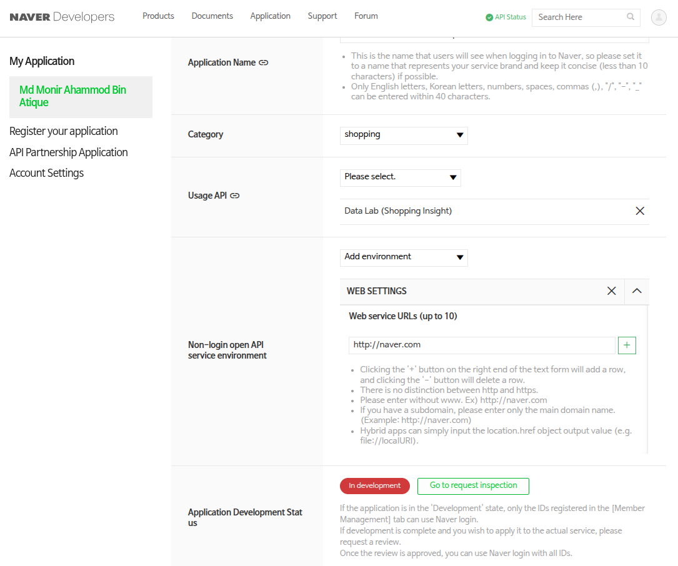
Naver Product API Call
Naver API Use Appliaction
11

Slide 13
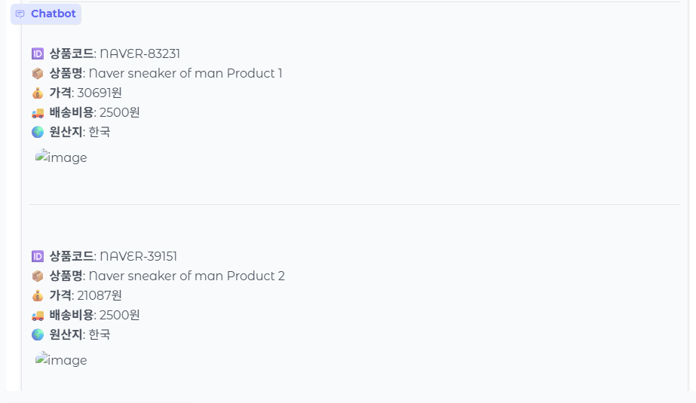
Naver Product Integration
User Query: Sneaker for men
No Image Preview for Naver API
12

Slide 14
Next Tasks To Do
Next Step
Integrate Naver api call properly for the images also.
Support alternative suggestions.
13

Slide 15
Thank You for Listening.
14

